Slide 1
Object Oriented Programming and Design
Presented by
Dr Ramya Devi M
mramyadevi@wilp.bits-pilani.ac.in
CS - 08 : 23rd Aug 2025

Slide 2
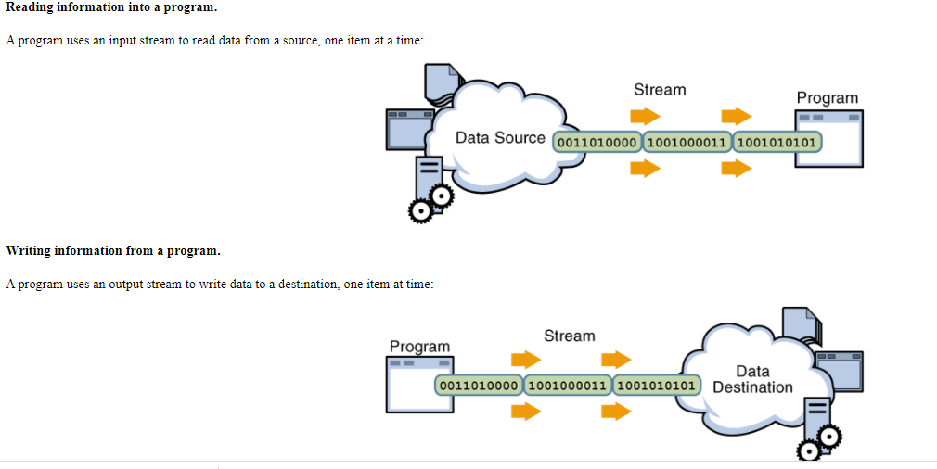
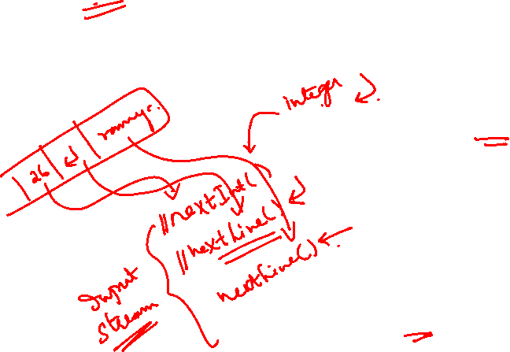
Streams
become familiar with the concept of an I/O stream
understand the difference between binary files and text files
learn how to save data in a file
learn how to read data from a file

Slide 3

Files and Streams
Java views each files as a sequential stream of bytes
Operating system provides mechanism to determine end of file
- End-of-file marker
- Count of total bytes in file
Java program processing a stream of bytes receives an indication from the operating system when program reaches end of stream
The java.io package defines I/O in terms of streams.
Streams are ordered sequences of data that have a source (input streams) or destination (output streams).
The I/O classes isolate programmers from the specific details of the underlying operating system, while enabling access to system resources through files and other means.

Slide 4
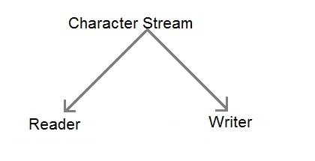
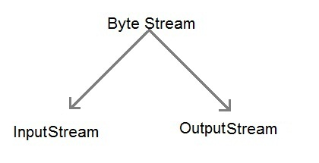
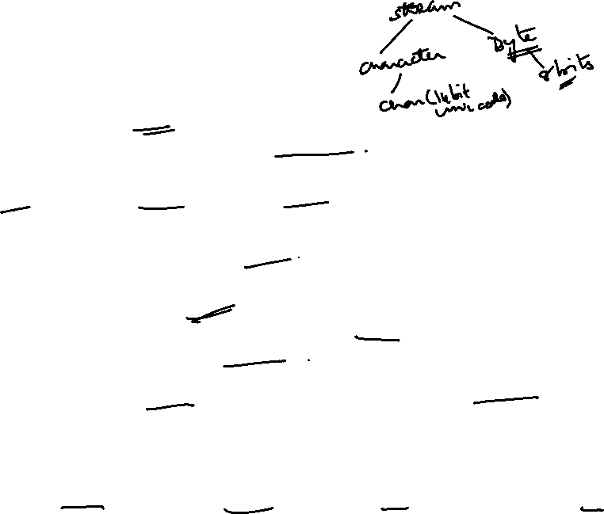
Streams
The package java.io has two major parts: character streams and byte streams. Characters are 16-bit UTF-16 characters, whereas bytes are (as always) 8 bits.
I/O is either text-based or data-based (binary).
Text-based I/O works with streams of human-readable characters, such as the source code for a program.
Data-based I/O works with streams of binary data, such as the bit pattern for an image.
The character streams are used for text-based I/O, while byte streams are used for data-based I/O.

Slide 5
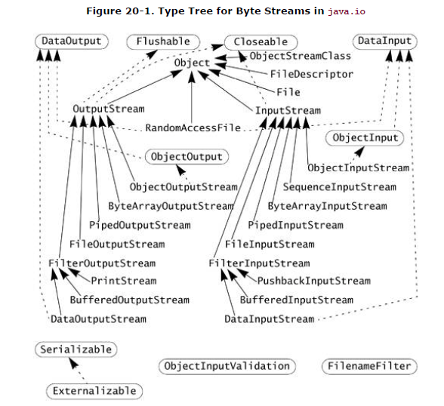
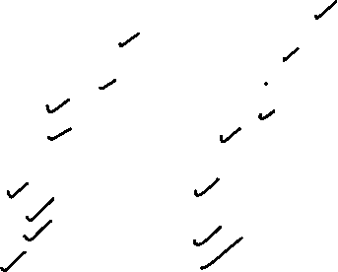
Byte Streams
The java.io package defines abstract classes(InputStream and OutputStream abstract classes) for basic byte input and output streams.
These abstract classes are then extended to provide several useful stream types. Stream types are almost always paired:
For example, where there is a FileInputStream to read from a file, there is usually a FileOutputStream to write to a file.

Slide 6
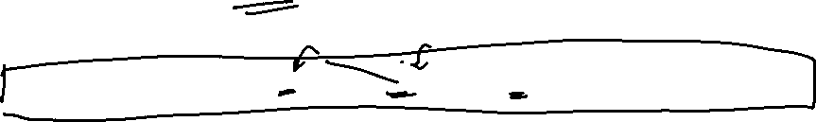
Byte Streams
InputStream
The abstract class InputStream declares methods to read bytes from a particular source.
InputStream is the superclass of most byte input streams in java.io, and has the following methods:
public abstract int read() throws IOException
- Reads a single byte of data and returns the byte that was read, as an integer in the range 0 to 255
public int read(byte[] buf, int offset, int count) throws IOException
- Reads into a part of a byte array.
The maximum number of bytes read is count.
The bytes are stored from buf[offset] up to a maximum of buf [offset+count-1]all other values in buf are left unchanged.
The number of bytes actually read is returned.
If no bytes are read because the end of the stream was found, the value -1 is returned.

Slide 7
class Main
{
public static void main(String args[])
{
byte b[] = new byte[10];
try {
System.in.read(b);
} catch(Exception e) {
System.out.println(e);
}
String s = new String(b);
System.out.println(s);
}
}

Slide 8
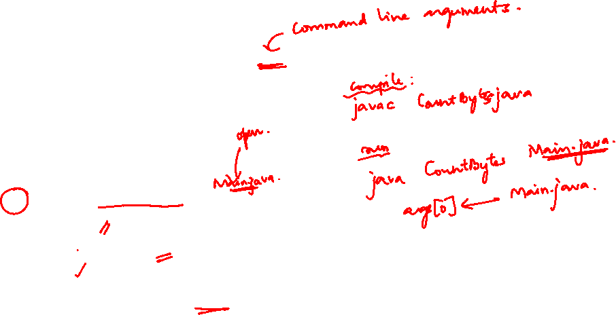
STREAM CLASSES - InputStream
The following program demonstrates the use of input streams to count the total number of bytes in a file, or from System.in if no file is specified:
import java.io.*;
class CountBytes {
public static void main(String[] args) throws IOException
{
InputStream in;
if (args.length == 0)
in = System.in;
else
in = new FileInputStream(args[0]);
int total = 0;
while (in.read() != -1)
total++;
System.out.println(total + " bytes");
} }
8

Slide 9
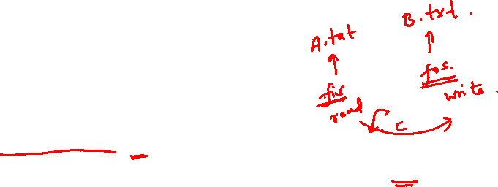
STREAM CLASSES - Example program for FileInput and FileOutput Stream classes
Following is an example which makes use of these two classes to copy an input file into an output file:
import java.io.*;
class StreamDemo1
{
public static void main(String aa[ ] )
{
FileInputStream fis=new FileInputStream(“A.txt”);
FileOutputStream fos=new FileOutputStream(“B.txt”);
int c;
While( (c=fis.read()) !=-1) fos.write(c);
fis.close();
fos.close();
}
}
9
Object Oriented Programming

Slide 10
STREAM CLASSES
Assume that A.txt file has some content
Java is a portable language.
As a next step, compile the above program and execute it, which will result in creating B.txt file with the same content as we have in A.txt. So let's put the above code in StreamDemo1.java file and do the following
>javac StreamDemo1.java [Compilation to Byte Code]
>java StreamDemo1
10

Slide 11
STREAM CLASSES - OutputStream
The abstract class OutputStream is analogous to InputStream; it provides an abstraction for writing bytes
to a destination.
Its methods are:
public abstract void write(int b) throws IOException
Writes b as a byte.
The byte is passed as an int because it is often the result of an arithmetic operation on a byte.
public void write(byte[] buf, int offset, int count) throws IOException
Writes part of an array of bytes, starting at buf[offset] and writing count bytes.
This method blocks until the bytes have been written.
11

Slide 12
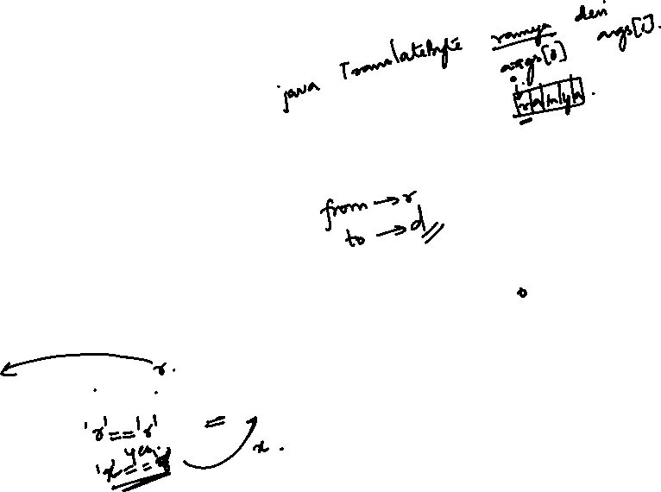
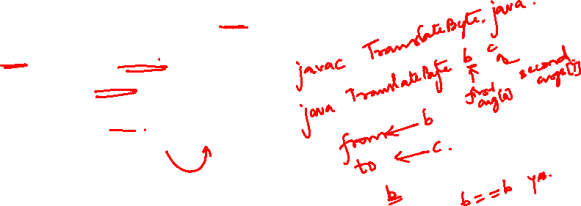
STREAM CLASSES - OutputStream
Here is a program that copies its input to its output, translating one particular byte value to a different one along the way. The TRanslateByte program takes two parameters: a from byte and a to byte. Bytes that match the value in the string from are translated into the value in the string to.
import java.io.*;
class TranslateByte {
public static void main(String[] args) throws IOException
{
byte from = (byte) args[0].charAt(0);
byte to = (byte) args[1].charAt(0);
int b;
while ((b = System.in.read()) != -1)
System.out.write(b == from ? to : b);
}
}
For example, if we invoked the program as
java TranslateByte b B
and entered the text abracadabra!, we would get the output
abracadabra!
12

Slide 13
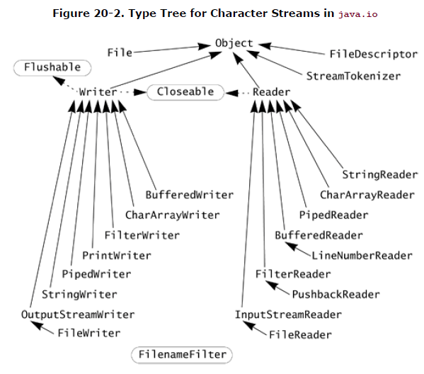
Character Streams
The abstract classes for reading and writing streams of characters are Reader and Writer.

Slide 14
Character Streams
Reader
The abstract class Reader provides a character stream analogous to the byte stream InputStream and the methods of Reader essentially mirror those of InputStream:
public int read() throws IOException
Reads a single character and returns it as an integer in the range 0 to 65535.
If no character is available because the end of the stream has been reached, the value -1 is returned.
public abstract int read(char[] buf, int offset, int count) throws IOException
Reads into a part of a char array.
The maximum number of characters to read is count.
The read characters are stored from buf[offset] up to a maximum of buf[offset+count-1]all other values in buf are left unchanged.
The number of characters actually read is returned.

Slide 15
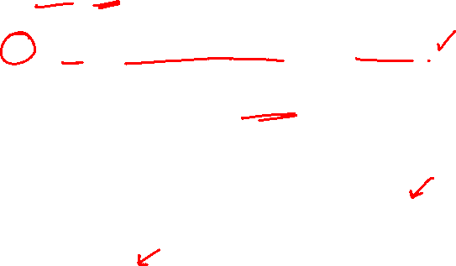
Character Streams
import java.io.*;
class CountSpace {
public static void main(String[] args) throws IOException {
Reader in;
if (args.length == 0)
in = new InputStreamReader(System.in);
else
in = new FileReader(args[0]);
int ch;
int total;
int spaces = 0;
for (total = 0; (ch = in.read()) != -1; total++) {
if (Character.isWhitespace((char) ch))
spaces++; }
System.out.println(total + " chars, "+ spaces + " spaces"); }
}
As an example, the program counts the number of whitespace characters in a character stream:

Slide 16
Character Streams
The abstract class Writer provides a stream analogous to OutputStream but designed for use with characters instead of bytes.
public void write(int ch) throws IOException
Writes ch as a character.
The character is passed as an int but only the lowest 16 bits of the integer are written.
public abstract void write(char[] buf, int offset, int count) throws IOException
Writes part of an array of characters, starting at buf[offset] and writing count characters.

Slide 17
Buffering
Not buffered: each byte is read/written from/to disk as soon as possible
“little” delay for each byte
A disk operation per byte---higher overhead
Buffered: reading/writing in “chunks”
Some delay for some bytes
Assume 16-byte buffers
Reading: access the first 4 bytes, need to wait for all 16 bytes are read from disk to memory
Writing: save the first 4 bytes, need to wait for all 16 bytes before writing from memory to disk
A disk operation per a buffer of bytes---lower overhead
The Buffered stream classes BufferedInputStream, BufferedOutputStream, BufferedReader, and BufferedWriterbuffer their data to avoid every read or write going directly to the next stream.
These classes are often used in conjunction with File stream accessing a disk file is much slower than using a memory buffer, and buffering helps reduce file accesses.

Slide 18
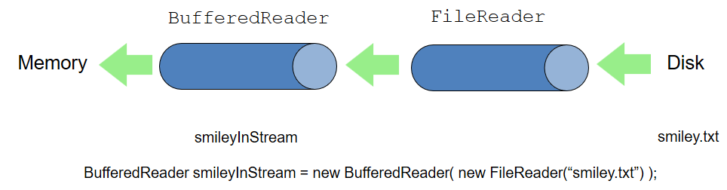
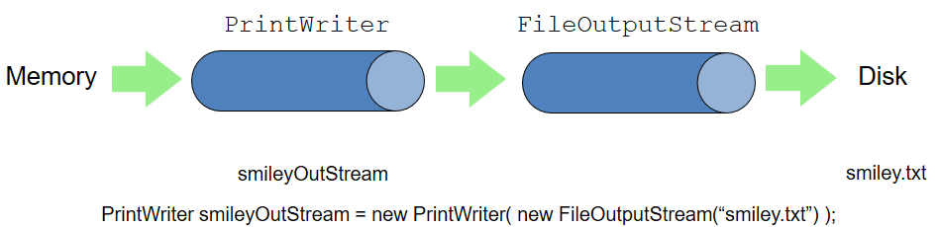
Input/Output File Streams

Slide 19
STREAM CLASSES - Example program for FileReader and FileWriter Stream classes
Following is an example which makes use of these two classes to copy an input file into an output file:
import java.io.*;
class StreamDemo2
{
public static void main(String aa[ ] )
{
FileReader fr=new FileReader(“A.txt”);
FileWriter fw=new FileWriter(“B.txt”);
int c;
While( (c=fis.read()) !=-1) fos,write((char)c);
fr.close();
fw.close();
}
}

Slide 20
STREAM CLASSES
Assume that A.txt file has the content
Java is an Object Oriented language.
As a next step, compile the above program and execute it, which will result in creating B.txt file with the same content as we have in A.txt. So let's put the above code in StreamDemo1.java file and do the following
>javac StreamDemo2.java [ Compilation to Byte Code ]
>java StreamDemo2

Slide 21
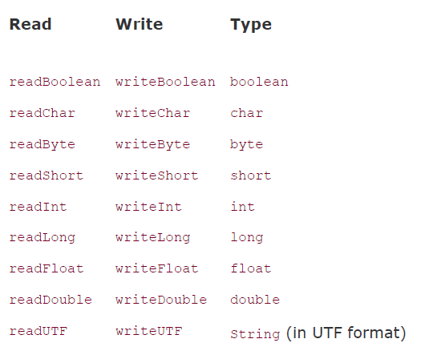
The Data Byte Streams
Reading and writing text characters is useful, but you also frequently need to transmit the binary data of specific types across a stream.
The DataInput and DataOutput interfaces define methods that transmit primitive types across a stream. The classes DataInputStream and DataOutputStream provide a default implementation for each interface.

Slide 22
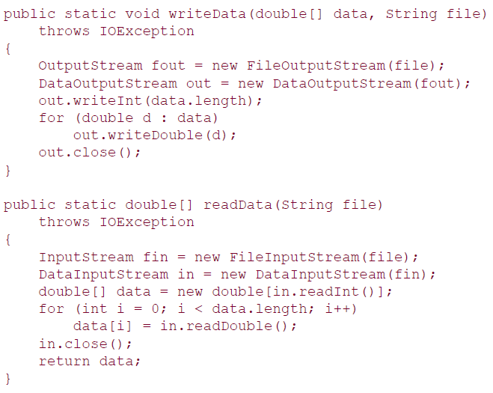
The Data Byte Streams

Slide 23
STREAM CLASSES - DATA INPUT STREAM
DataInputStream class is descended from the InputStream class so it has all behaviors of a byte input stream.
In addition, it implements the DataInput interface which defines the following read operations for primitive types and Strings:
readBoolean(): Reads one input byte and returns true if that
byte is nonzero, false if that byte is zero.
readByte(): Reads and returns one input byte.
readChar(): Reads 2 input bytes and returns a char value.
readDouble():Reads 8 input bytes and returns a double value.

Slide 24
DATA INPUT STREAM
readFloat(): Reads 4 input bytes and returns a float value.
readInt(): Reads 4 input bytes and returns an int value.
readLong(): Reads 8 input bytes and returns a long value.
readShort(): Reads 2 input bytes and returns a short value.

Slide 25
DATA OUTPUT STREAM
DataOutputStream class is descended from the OutputStream class so it inherits all behaviors of a byte output stream. In addition, it implements the DataOutput interface which defines the following write operations for primitive types and Strings:
writeBoolean(boolean v): Writes a boolean to the underlying output stream as a 1-byte value.
writeByte(int v): Writes out a byte to the underlying output stream as a 1-byte value.
writeInt(int v): Writes an int to the underlying output stream as four bytes, high byte first.
writeLong(long v): Writes a long to the underlying output stream as eight bytes, high byte first.
writeShort(int v): Writes a short to the underlying outputstream as two bytes, high byte first.

Slide 26
DATA OUTPUT STREAM
writeBytes(String s): Writes out the string to the underlying output stream as a sequence of bytes.
writeChar(int v): Writes a char to the underlying output stream as a 2-byte value, high byte first.
writeChars(String s): Writes a string to the underlying output stream as a sequence of characters.
writeDouble(double v): Converts the double argument to a long using the doubleToLongBits method in class Double,
and then writes that long value to the underlying output stream as an 8-byte quantity, high byte first.
writeFloat(float v): Converts the float argument to an int using the floatToIntBits method in class Float, and then writes that int value to the underlying output stream as a 4-byte quantity, high byte first.

Slide 27
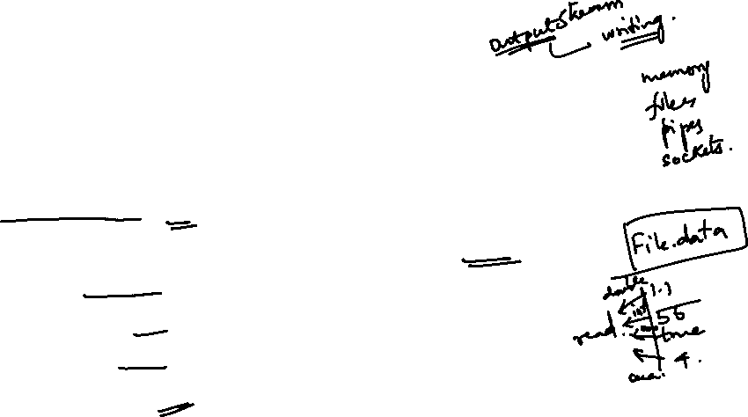
STREAM CLASSES - Example
Example program for DataInputStream and
DataOutputStream
import java.io.*;
class DataOutputStreamDemo
{
public static void main(String args[]) throws IOException
{
DataOutputStream dout = new DataOutputStream(new
FileOutputStream("file.dat"));
dout.writeDouble(1.1);
dout.writeInt(55);
dout.writeBoolean(true);
dout.writeChar('4');

Slide 28
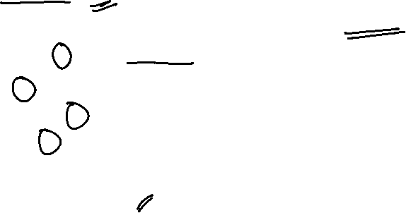
STREAM CLASSES - Example
// reading the data back using DataInputStream
DataInputStream din = new DataInputStream(new
FileInputStream("file.dat"));
double a = din.readDouble();
int b = din.readInt();
boolean c = din.readBoolean();
char d=din.readChar();
System.out.println("Values: " + a + " " + b + " " + c+" " + d);
}
}

Slide 29
ObjectInputStream and ObjectOutputStream
ObjectInputStream and ObjectOutputStream
The ObjectInputStream is used to read the object written by using ObjectOutputStream.
The ObjectOutputStream is used to write the object that can be read by using
ObjectOutputStream.
Serialization is an important concept that deals with the conversion of objects into a byte stream to transport the java objects from one Java Virtual Machine to the other and recreate them to the original form.

Slide 30
ObjectInputStream and ObjectOutputStream - Example
import java.io.*;
class Demo implements Serializable
{ int a;
String b;
public Demo(int a, String b)
{
this.a = a;
this.b = b;
}
}

Slide 31
ObjectInputStream and ObjectOutputStream - Example
class Test
{
public static void main(String[] args)
{
Demo object = new Demo(100, “Sachin");
FileOutputStream file = new FileOutputStream(“MyFile”);
ObjectOutputStream out = new
ObjectOutputStream(file);
out.writeObject(object);
out.close();
file.close();
System.out.println("Object has been serialized");
}
}

Slide 32
Example - Serialize an Object
import java.io.*;
public class Test1
{
public void saveObject(String outputFilename, Object anObject)
{
try
{
FileOutputStream fpout = new FileOutputStream(outputFilename);
ObjectOutputStream obOut = new ObjectOutputStream(fpout);
obOut.writeObject(anObject);
obOut.flush();
obOut.close();
}
catch (IOException x)
{
System.out.println("Error:" + x);
}
}
}

Slide 33
Example - Read in a Serialized Object
import java.io.*;
public class Test2
{
public Object readObject(String inputFilename)
{
try
{
FileInputStream fpin = new FileInputStream(inputFilename);
ObjectInputStream obIn = new ObjectInputStream(fpin);
Object anObject = obIn.readObject();
obIn.close();
return anObject;
}
catch (IOException x)
{
System.out.println("Error:" + x);
}
}
}

Slide 34
The File Class
Java IO provides a class which is an abstract representation of a file or directory within the file system.
The File class has 2 constructors:
File(String pathName)
File(File parent, String child)
The File class provides several query methods:
canRead(), canWrite(), exists(), getAbsolutePath(), getName(), getParent(), getPath(), isAbsolute(), isDirectory(), isHidden(), lastModified(), length(), and list()
The File class also provides several methods which act on the file system:
createTempFile(), delete(), deleteOnExit(), mkdir(), mkdirs(), renameTo(), setLastModified(), setReadOnly()

Slide 35
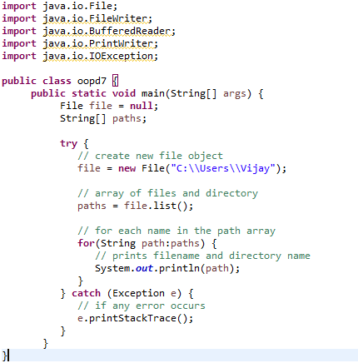
File operations
become familiar with the concept of an I/O stream
understand the difference between binary files and text files
learn how to save data in a file
learn how to read data from a file

Slide 36
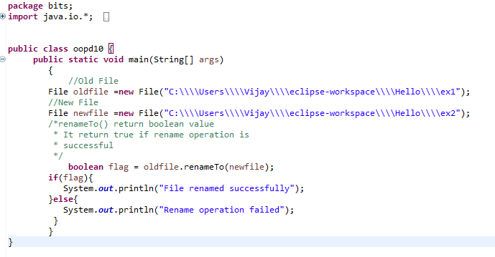
File operations – Rename a file
become familiar with the concept of an I/O stream
understand the difference between binary files and text files
learn how to save data in a file
learn how to read data from a file

Slide 37
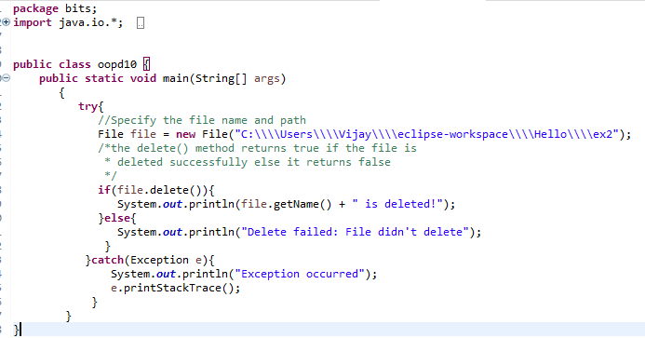
File operations – Delete a file
become familiar with the concept of an I/O stream
understand the difference between binary files and text files
learn how to save data in a file
learn how to read data from a file

Slide 38
Binary Versus Text Files
All data and programs are ultimately just zeros and ones
each digit can have one of two values, hence binary
bit is one binary digit
byte is a group of eight bits
Text files: the bits represent printable characters
one byte per character for ASCII, the most common code
for example, Java source files are text files
so is any file created with a "text editor"
Binary files: the bits represent other types of encoded information, such as executable instructions or numeric data
these files are easily read by the computer but not humans
they are not "printable" files
actually, you can print them, but they will be unintelligible
"printable" means "easily readable by humans when printed"

Slide 39
Java: Text Versus Binary Files
Text files are more readable by humans
Binary files are more efficient
computers read and write binary files more easily than text
Java binary files are portable
they can be used by Java on different machines
Reading and writing binary files is normally done by a program
text files are used only to communicate with humans
Java Text Files
Source files
Occasionally input files
Occasionally output files
Java Binary Files
Executable files (created by compiling source files)
Usually input files
Usually output files

Slide 40
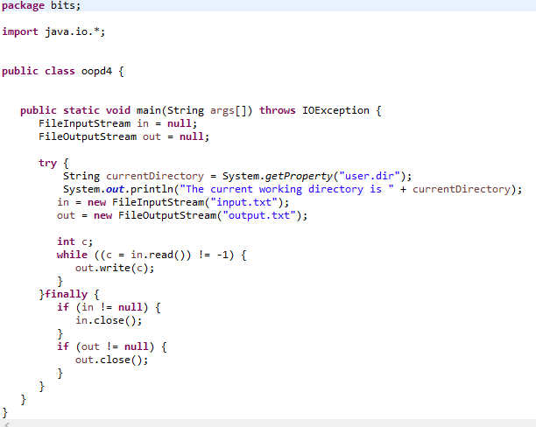
Example
become familiar with the concept of an I/O stream
understand the difference between binary files and text files
learn how to save data in a file
learn how to read data from a file

Slide 41
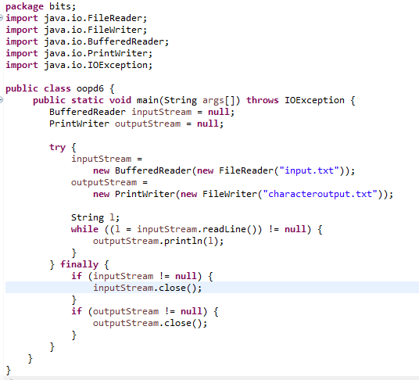
To read a line
become familiar with the concept of an I/O stream
understand the difference between binary files and text files
learn how to save data in a file
learn how to read data from a file

Slide 42
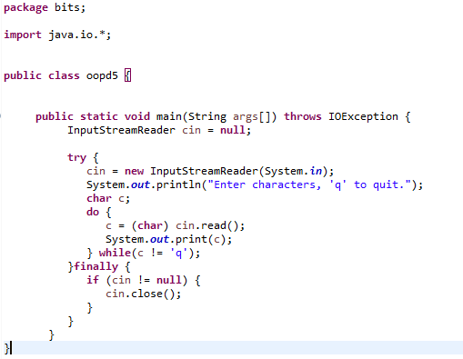
To read from console
become familiar with the concept of an I/O stream
understand the difference between binary files and text files
learn how to save data in a file
learn how to read data from a file

Slide 43
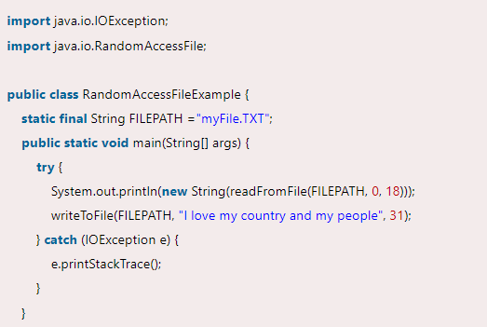
Random Access File
become familiar with the concept of an I/O stream
understand the difference between binary files and text files
learn how to save data in a file
learn how to read data from a file

Slide 44
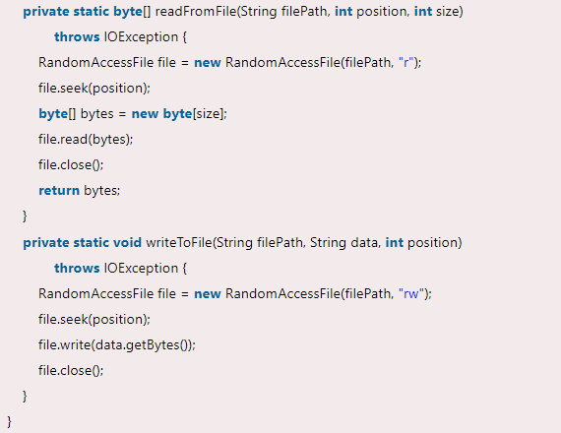
Random Access File
become familiar with the concept of an I/O stream
understand the difference between binary files and text files
learn how to save data in a file
learn how to read data from a file

Slide 45
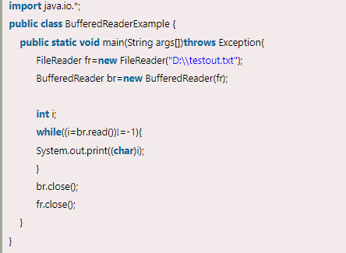
BufferedReader
become familiar with the concept of an I/O stream
understand the difference between binary files and text files
learn how to save data in a file
learn how to read data from a file

Slide 46
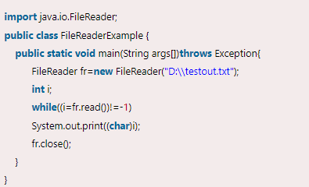
File reader & BufferedReader

Slide 47
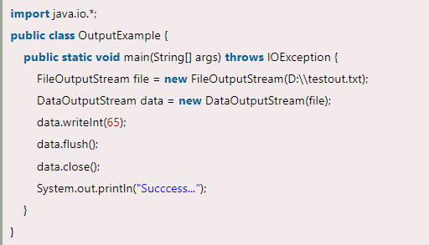
DataOutputStream
become familiar with the concept of an I/O stream
understand the difference between binary files and text files
learn how to save data in a file
learn how to read data from a file

Slide 48
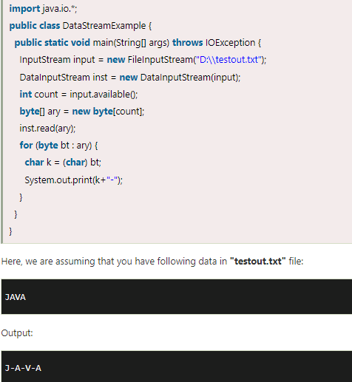
DataInputStream

